Slide 1
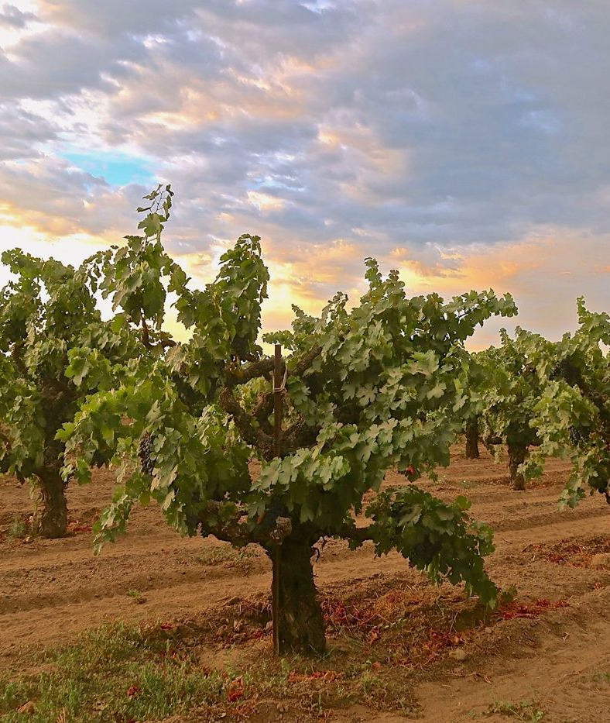
Italian Expansion
Program
Piedmont and Tuscany Sourcing Initiative
Atkins and Associates Fine Wines | February 2026

Slide 2
The Opportunity
Fifteen years of West Coast distribution earned the relationships that make a direct import program credible. The next chapter is traditional Nebbiolo and Sangiovese, sourced at the estate, priced FOB Genoa, and carried under the same temperature controlled line that protects every case in the book.
5
4
920
28 day
Target producers
Appellations
Cases, year one
Cold chain transit
Lead candidate Tenuta Marchetti, through Sofia Marchetti, with introductions to three further estates. Draft agreement pending review by attorney Richard Stein.

Slide 3
Producer Shortlist
Estate | Commune | Style | Role
Tenuta Marchetti | Barolo | Traditional Nebbiolo | Lead, in legal review
Cascina Valle | La Morra | Polished, fruit forward | By the glass, Bottega
Poderi Serralunga | Serralunga d'Alba | Structured, age worthy | Reserve, Le Jardin Dore
Tenuta Boscareto | Castiglione Falletto | Elegant, balanced | Small allocation
Vigna Antica | Monforte d'Alba | Bold, traditional | Exclusivity to clarify
Cantina Rivalta | Barolo village | Modern cellar | Second wave option

Slide 4
Proposed Allocation, Year One
FOB pricing, EUR per case
Barolo DOCG, 420
Barbaresco DOCG, 390
Langhe Nebbiolo, 168
Barbera d'Alba, 132
Quoted FOB Port of Genoa
Onward carriage to Oakland

Slide 5
Cold Chain Carriage, Cost per Container
Recommendation
Stay with the current exclusive line for continuity, capacity, and a fixed rate. Continuous temperature logging and 300,000 dollar spoilage cover per load.

Slide 6
The Route, October 14 to 22, 2026
Oct 14 to 15
Barolo
Arrive Alba. Tenuta Marchetti, taste 2019 and 2020 from barrel, review terms.
Oct 16
Barbaresco
Two estate visits through Sofia. Single vineyard focus. Tasting dinner in Alba.
Oct 17
La Morra
A third Piedmont estate, compare cru sites. Revisit Marchetti samples.
Oct 18 to 19
Montalcino
Transfer to Tuscany. Brunello visits, evaluate a 2017 and 2019 vertical.
Oct 20 to 22
Chianti, home
Sangiovese in the hills, consolidate in Florence, return via Frankfurt.

Slide 7
Revenue Trajectory with the Italian Program
Base portfolio grows 12 percent. Italy is expected to lift both revenue and goodwill once agreements are signed.

Slide 8

Next Steps
Confirm Tenuta Marchetti and execute after legal review
Prioritize Cascina Valle and Poderi Serralunga for range
Finalize the October sourcing trip and estate appointments
Lock the cold chain lane and Schedule B rate
Monitor European tariff exposure before committing volume
Target four to five producers confirmed by year end.

